Slide 1
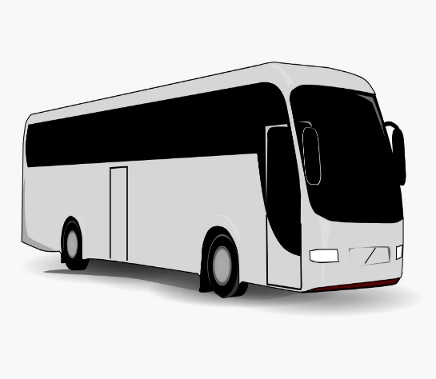
GOBUS
ONLINE BUS BOOKING SYSTEM
GROUP- 02

Slide 2
TEAM MEMBERS
S.No | Names
1 | Donthu Jyoshna(TeamLead,sBackend Lead)
2 | T Sundupalli Aravind
3 | Yadla Raviteja
4 | Akula Neelima Devi
5 | D Sneaga
6 | Rajat Sharma(Frontend Lead)
7 | Swetha M
8 | Sidharth Shankar Sonu

Slide 3
TEAM DISTRIBUTION
Backend Team
Donthu Jyoshna
T Sundupalli Aravind
Yadla RaviTeja
Neelimadevi Akula
Frontend Team
Rajat Sharma
Sidharth Shankar Sonu
D Sneaga
Swetha M

Slide 4
INTRODUCTION
The Online Bus Booking System is a web-based application that allows a user to check ticket availability, buy ticket and pay for the bus ticket online.
The bus booking system is based on Java Spring Boot, MySQL and Angular. Role based authorization and authentication is given to both admin and user.

Slide 5
SCOPE
The scope of the online bus booking system is:
A person should be able to Login to the system through the first page of the application.
Otherwise we can register into the system.
Should be able to create a new login for accessing the reservation facility.
Able to search and book the particular bus.

Slide 6
Technologies used in Backend
Spring Boot
Maven
Spring Data JPA
JDK 11
MySQL Database
Hibernate

Slide 7
Dependencies:
Spring-Boot Data JPA
Spring-Boot Dev Tools
Spring-Web
My SQL-Connector
Lombok
Spring Starter Security

Slide 8
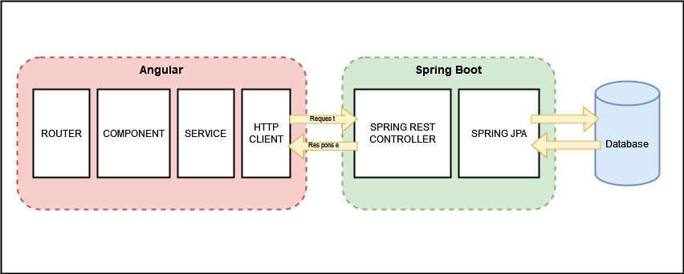
Web Application Block Diagram

Slide 9
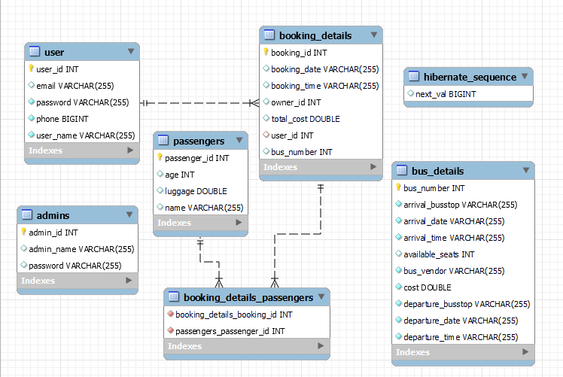
ER Diagram

Slide 10

Modules in Backend
Entity
Controller
DAO
Service
Service Implementation (ServiceImpl)
Security
Util
Exception
Test Modules

Slide 11
Entity Module
Entity module defines the basic entities required for this application that are stored in the database. Each entity is represented in the form of tables in the Database.
Those entities are
Admin: Defines the Admin entity with 3 properties which are Admin ID, Admin Name and Password.
Booking Details: Defines the entity with following properties. Booking ID, Booking Date, Booking Time, Total Cost, Bus Number and User ID.
Bus Details: It has following properties. Bus number, Departure stop, Arrival stop, Available seats, Departure date, Arrival date, Arrival time, Departure time, Bus vendor and Cost.
Passenger: It is defined with following properties Passenger ID, Name, Age and Luggage.
User: It has following properties such as User ID, User Name, Password, Email and Phone. User entity is related with Booking details entity in one to many relationship.

Slide 12
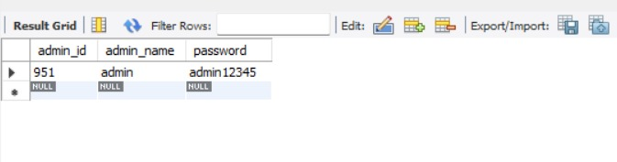
Admin Entity Class
This Defines the Admin entity with 3 properties which are Admin ID, Admin Name and Password.
Admin ID - Primary key
Admin Name - Column
Password - Column

Slide 13
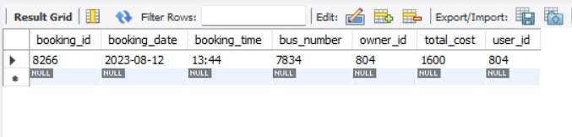
Booking Details Entity Class
Defines the entity with following properties. Booking ID, Booking Date, Booking Time, Total Cost, Bus Number and User ID.

Slide 14
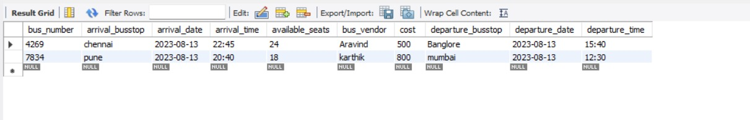
Bus Details Entity Class
It has following properties. Bus number, Departure stop, Arrival stop, Available seats, Departure date, Arrival date, Arrival time, Departure time, Bus vendor and Cost.

Slide 15
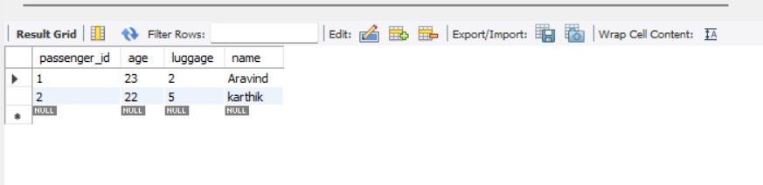
Passenger Entity Class
It is defined with following properties Passenger ID, Name, Age and Luggage.

Slide 16
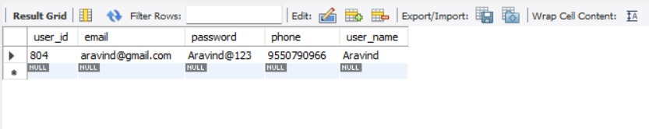
User Entity Class
It has following properties such as User ID, User Name, Password, Email and Phone. User entity is related with Booking details entity in one to many relationship.

Slide 17
Dao Layer
Data Access Object (DAO) pattern is a structural pattern that allows to isolate the application/business layer from persistence layer using an abstract API.
It is used to abstract the retrieval of data from a data resource such as a Database.
All the entity classes are extended to JPA repository in order to perform CRUD operations.
This application has DAO classes (or interfaces) for the defined entities, which are
Admin DAO
User DAO
Bus Details DAO
Booking Details DAO
Passenger DAO

Slide 18
Exception Module
Exception module has all the exception handling classes defined, that are used in this application.
It provides the proper exception messages and error propagation mechanisms.
All the exception Classes will implement runtime exception.
Some of the exception handling classes used in the application are AdminDoesnotExist,NullAdmin, RecordNotFound, RecordAlreadyPresent, UserAlredyExist and etc.

Slide 19
Util Module
This module has two classes.
Admin Authorization (AdminAuth)
User Authorization (UserAuth)
Both of these classes are used to set the Authorization values for the 2 entities namely Admin and User.
Admin entity has Admin ID and Password for admin login.
User entity has User ID and Password for user login.

Slide 20
Service and Service Implementation Modules
Service: The Service module declares the methods that are used by the entities.
Service module declares Admin Service and User Service classes which has many methods that are implemented in serviceImpl module.
Service Implementation (ServiceImpl): This module implements all the methods specified in the Service module classes. It also uses dependency injection technique to implement the Dao modules.
It defines the functions for both Admin Service and User Service classes.
Methods defined by this module are such as Add admin, Delete admin, Admin login, Add bus details, Update bus and etc. for Admin Service class and then User login, Add user, Delete user, Update user, Add booking, Delete booking and etc. for User Service class.

Slide 21
Service & ServiceImpl Methods
User Methods
public User addUser(User user);
public void updateUser(User user);
public User getUser(Integer userId);
public void deleteUser(Integer userId);
public User userLogin(UserAuth auth);
public BookingDetails addBooking(BookingDetails booking, Integer userId, Integer busNumber);
public void deleteBooking(Integer bookingId, Integer userId);
public List<BookingDetails> getBookingByUserId(Integer userId);
public BusDetails findByRouteAndDate(String arrivalBusstop, String departureBusstop, String date);
public BusDetails getBusByBusNumber(Integer busNumber);
public Passenger updatePassenger(Passenger passenger);
Admin Methods
public Admin addAdmin(Admin admin);
public Admin getAdmin(Integer adminId);
public void deleteAdmin(Integer adminId);
public Admin adminLogin(AdminAuth auth);
public List<BusDetails> getAllBusDetails();
public BusDetails addBusDetails(BusDetails details);
public void deleteBus(Integer busNumber);
public BusDetails updateBus(BusDetails details);
public List<Passenger> getAllPassengers();
public List<Passenger> getPassengersByBooking(Integer id);

Slide 22
Controller Module
Controller module provides the HTTP request and response mappings for the entities in the application between the application and the Database.
This application has two Controller components.
Admin Controller: This controller provides the HTTP request and response mappings for the Admin entity and the functionalities of that entity such as Admin login, Add admin, Delete admin, Add bus details, Update bus details and etc.
User Controller: User controller provides the HTTP mappings for user functionalities such as User login, Add user, Update user, Add booking, Delete Booking and etc.

Slide 23
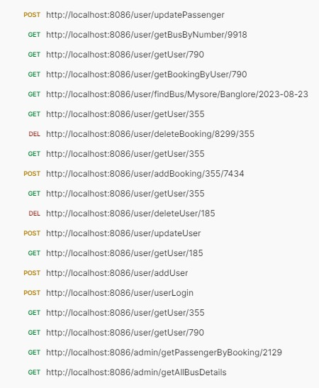
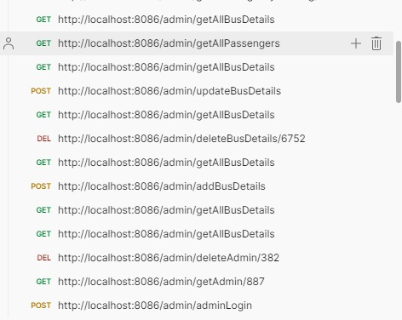
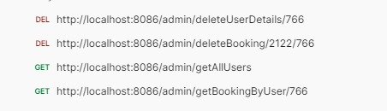
Postman Client Functional Testing Modules

Slide 24
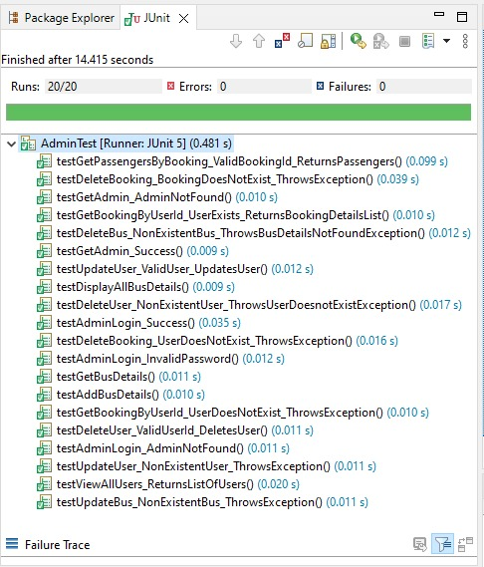
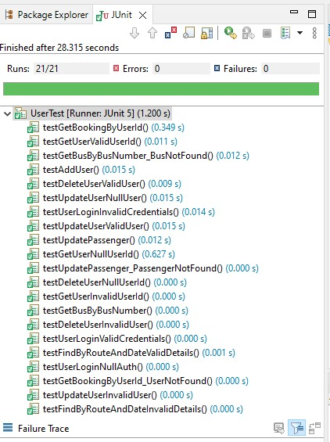
JUnit Tests

Slide 25

Technologies used in Frontend
VisualStudio Code IDE
Angular 14
Node js & Npm
TypeScript
Angular CLI
Bootstrap

Slide 26
ANGULAR
Angular is a framework and platform for building single-page client applications using HTML and Type Script . Angular is written in Type Script.
Great for Single page applications.
Angular is modular.
Built-in features DI, data binding etc.

Slide 27
Angular Module
Angular applications are modular and Angular has its own modularity system called Ng Modules. Ng Modules are containers for a cohesive block of code dedicated to an application domain, a workflow, or a closely related set of capabilities They can contain components, service providers, and other code files whose scope is defined by the containing Ng Module. They can import functionality that is exported from other Ng Modules, and export selected functionality for use by other Ng Modules.
Imports in module:
FormsModule
ReactiveFormsModule
HttpClientModule
BrowserModule
AppRoutingModule
Ng Module

Slide 28
Angular Routing
The Angular Router is an object that enables navigation from one component to the next component as users perform application tasks like clicking on menus links, buttons or clicking on back/forward button on the browser. We can access the router object and use its methods like navigate() or navigateByUrl(), to navigate to a route.
Router Link
The Router Link is a directive that binds the HTML element to a Route. Clicking on the HTML element, which is bound to a Router Link, will result in navigation to the Route. The Router Link may contain parameters to be passed to the route’s component.

Slide 29
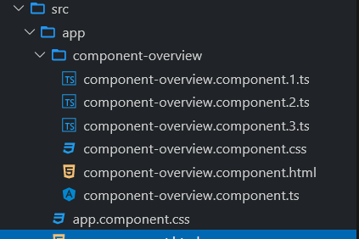
Angular Components
Components are the most basic UI building block of an Angular app. An Angular app contains a tree of Angular components. Angular components are a subset of directives, always associated with a template. Unlike other directives, only one component can be instantiated for a given element in a template.
Each component consists of
An HTML template that declares what renders on the page
A TypeScript class that defines behavior
A CSS selector that defines how the component is used in a template
Optionally, CSS styles applied to the template

Slide 30

Angular Components in the project
Home:
It is the Landing Page of the application. It has Navigation to Login and Register
Admin-Login:
Admin contains a page for login form and method to validate the Admin Login
User-Login:
User Login contains a page for user login form and a method to validate the user login.
User-Register:
This component contains a page for user registration form and method to store the details in Database.

Slide 31
Admin-Home:
After log-in as Admin, admin can perform two functional operations. Adding new Bus and viewing all the entries. This home page has an option to navigate the admin to perform these functionalities.
Add-Bus-Details:
This component contains a form inside a template page to add new bus details and TS file containing method to store the data entered in form into the database.
View-All-Bus-Details:
This component contains a viewing page which shows all the details and list of all the bus details and functionalities like updating bus details and deleting the existing bus from database.

Slide 32
User-Home:
After Login as User, User has 4 Functionalities Book Tickets for passengers, View Bookings, View User Details, Update User Details. This component contains the option to search the bus for user provided routing details and Route the user to add passenger details. This page also navigate the user to View Booking, View User Details, Update User Details.
Add-Passengers:
After selecting the bus, User needs to submit the passenger details of passengers in the form to store the data in the Database.
Show-User-booking:
This component contains all the bookings made by the logged in user. Can view the passenger and bus details for a specific booking.

Slide 33
Update-Passengers:
This component contains a form to update the passenger details and change it in data base.
View-User-details:
This component displays the user details.
Update-User:
This component contains a form to update the user details.
Error:
This component handles the error
Page-not-found:
This component handles 404 Error.

Slide 34
View All User Component:
This component displays all the users details from the admin side
View All Bookings:
This component displays all bookings of a user using user ID
About us:
This component provides information about the Online Bus Booking System
Contact us:
This component displays the contact details for customer support

Slide 35
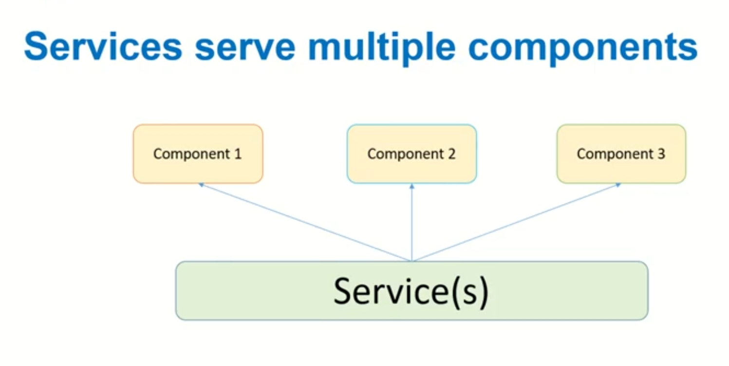
Angular Services
Service is a piece of reusable code with a focused purpose. A code that you will use across multiple components in your application.
Our components need to access the data. You can write data access code in each Component, but this is very inefficient and breaks the rule of single responsibility. The Component should focus on presenting the data to the user.
Command to generate service: ng g s <service_name>
There are two services in this application
Admin-Service
User-Service

Slide 36
Admin Service:
adminLogin()
getAdminDetails()
addBus()
modifybus()
removebus()
viewAllbus()
errorHandler()
User-Service:
addUser()
UserLogin()
addBooking()
getBookingbyUser(id)
deleteBooking()
updateUser()
getUser()
getBusbyNumber(busNumber)
addPassenger()
updatePassenger(passenger)
errorHandler

Slide 37
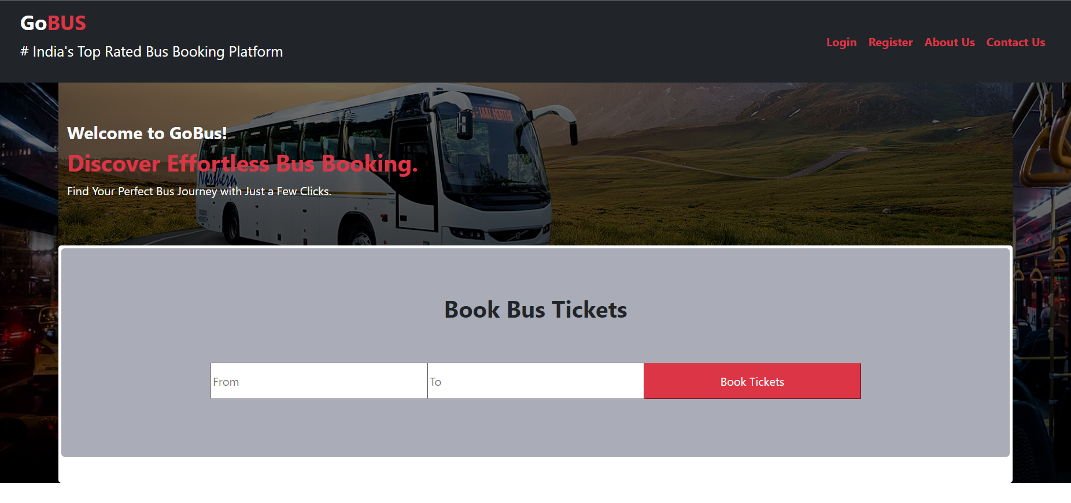
Home Page(Landing Page)

Slide 38
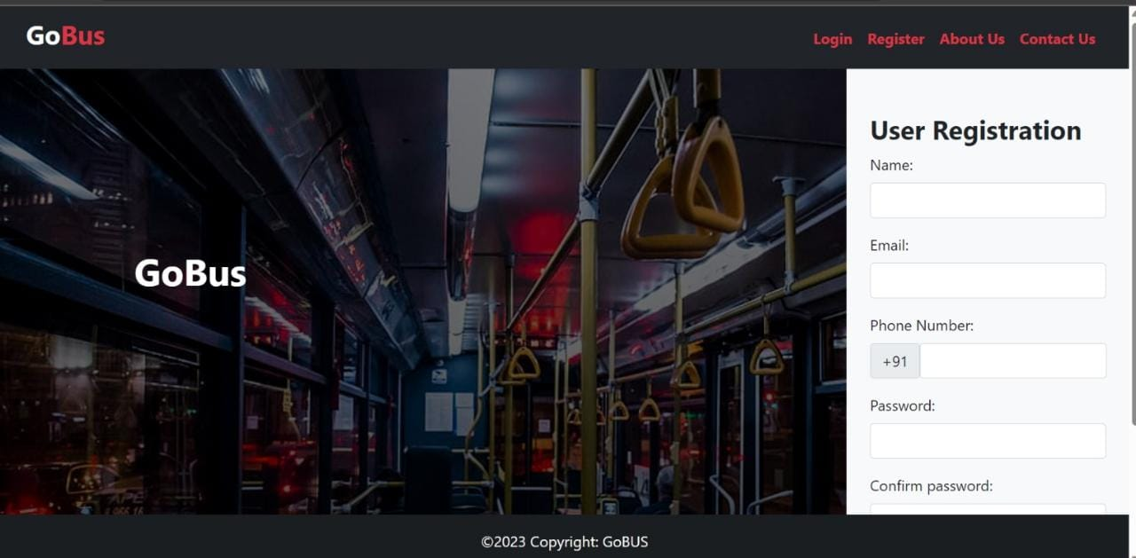
User Registration

Slide 39
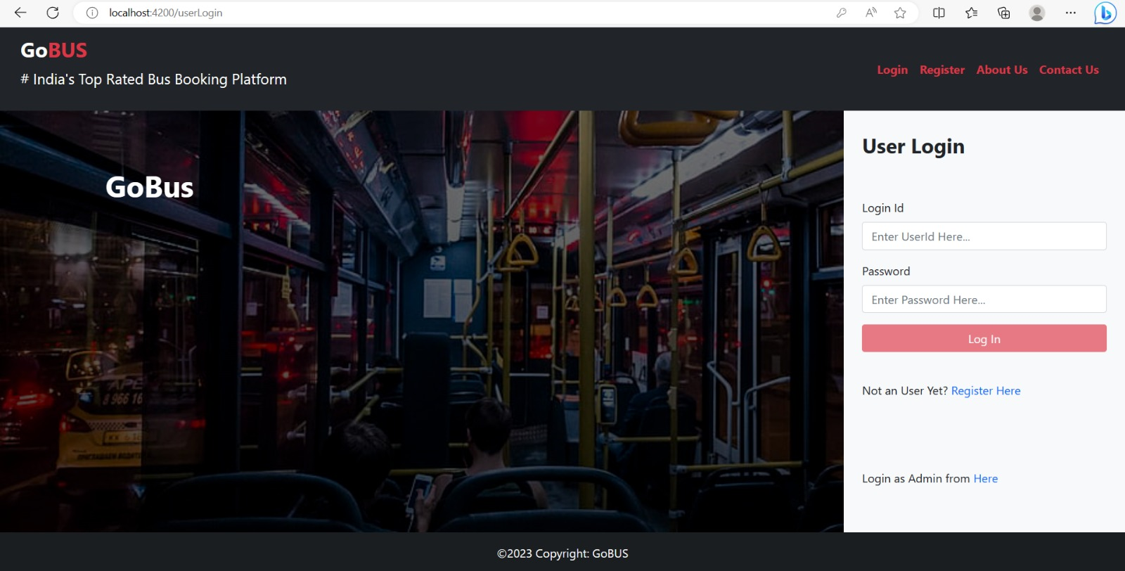
User login page

Slide 40

ADMIN LOGIN PAGE

Slide 41
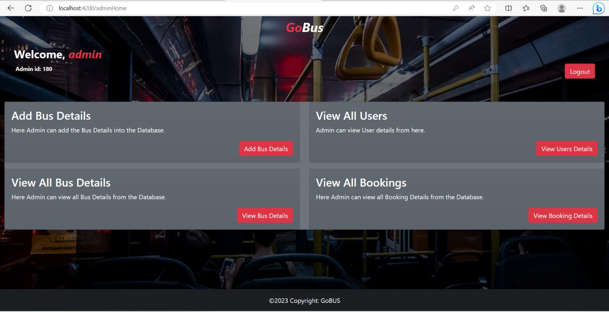
ADMIN HOME PAGE

Slide 42
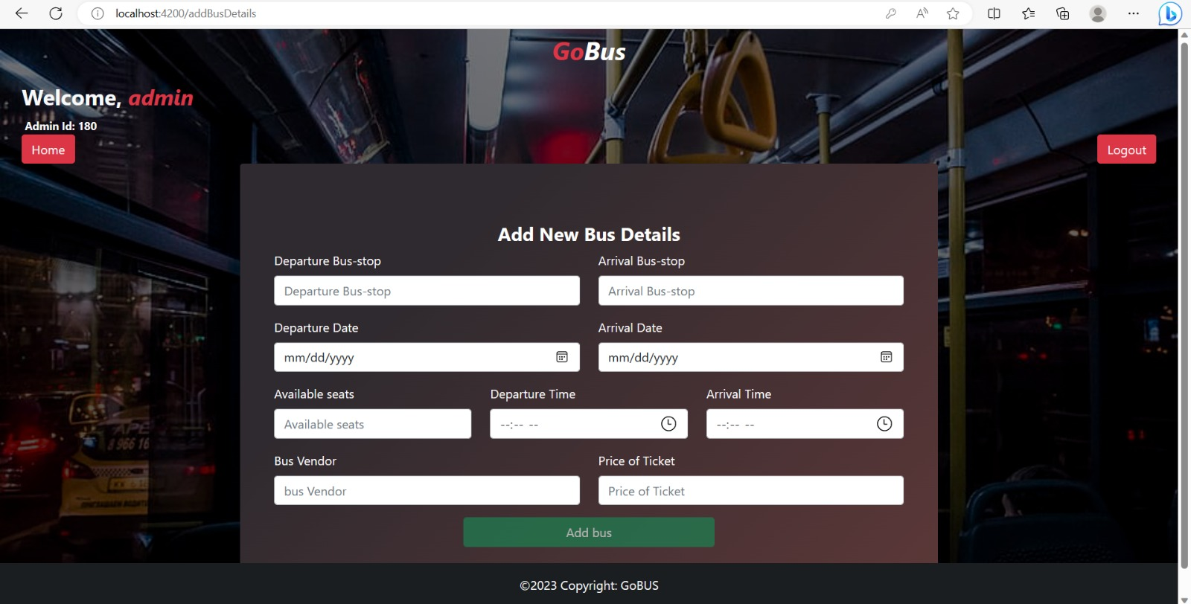
ADD NEW BUS DETAILS

Slide 43
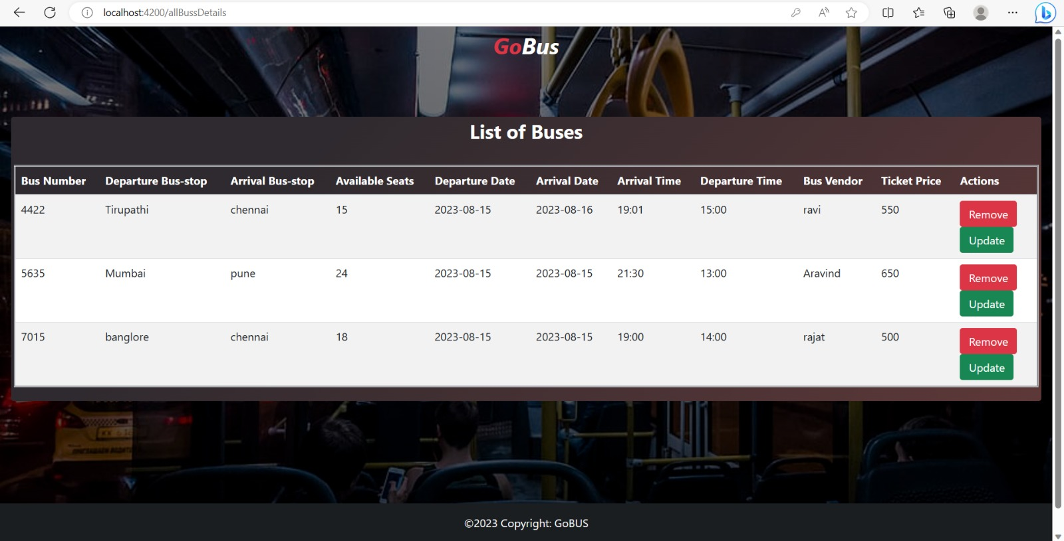
LIST OF BUSES

Slide 44
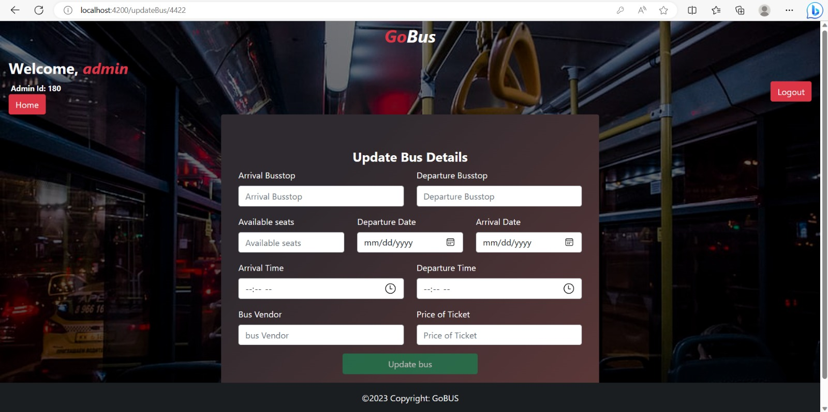
UPDATE BUS DETAILS

Slide 45
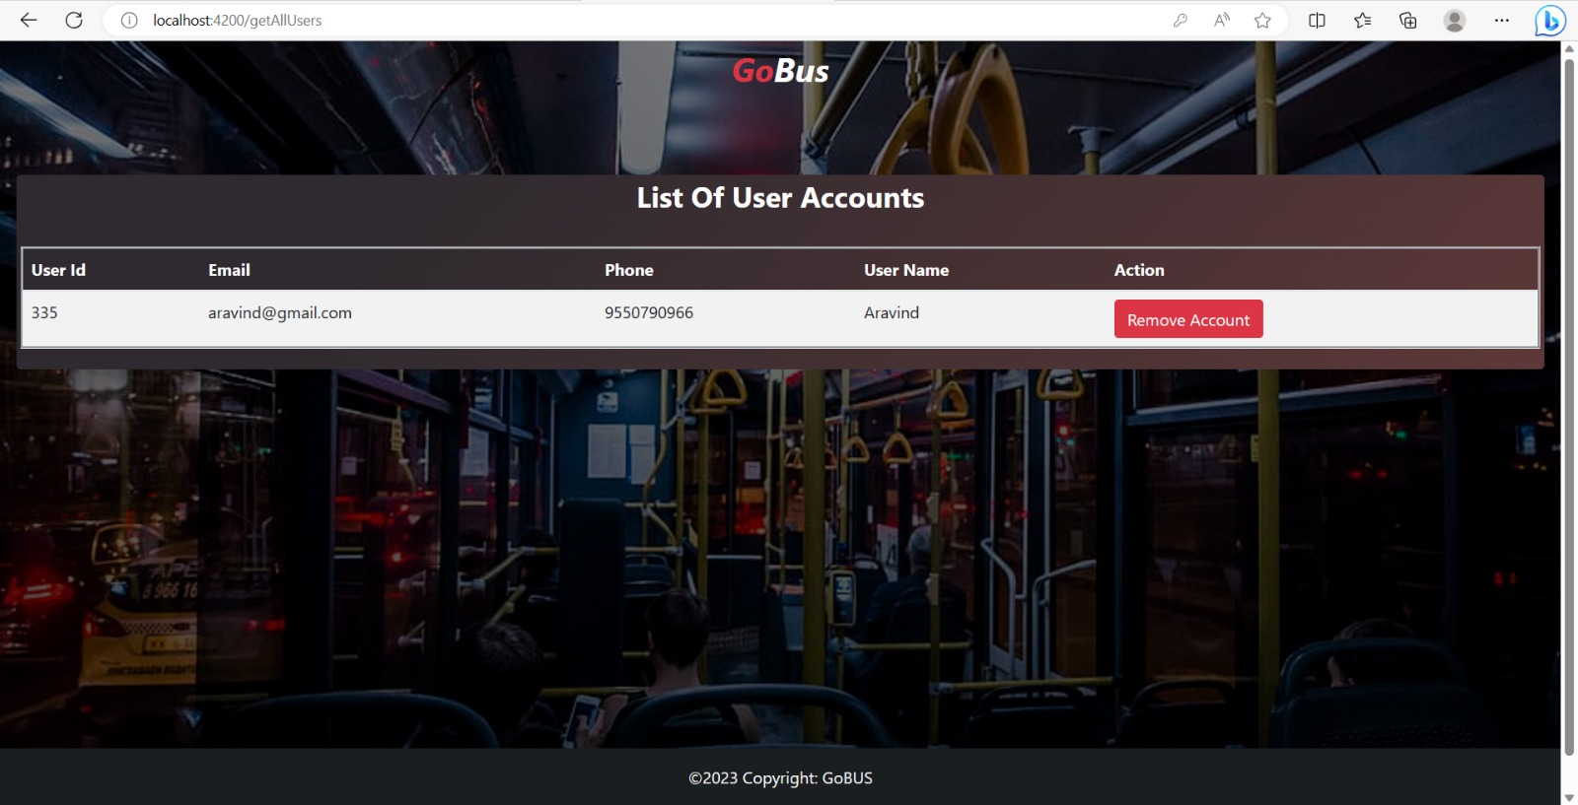
VIEW ALL USERS(ADMIN)

Slide 46
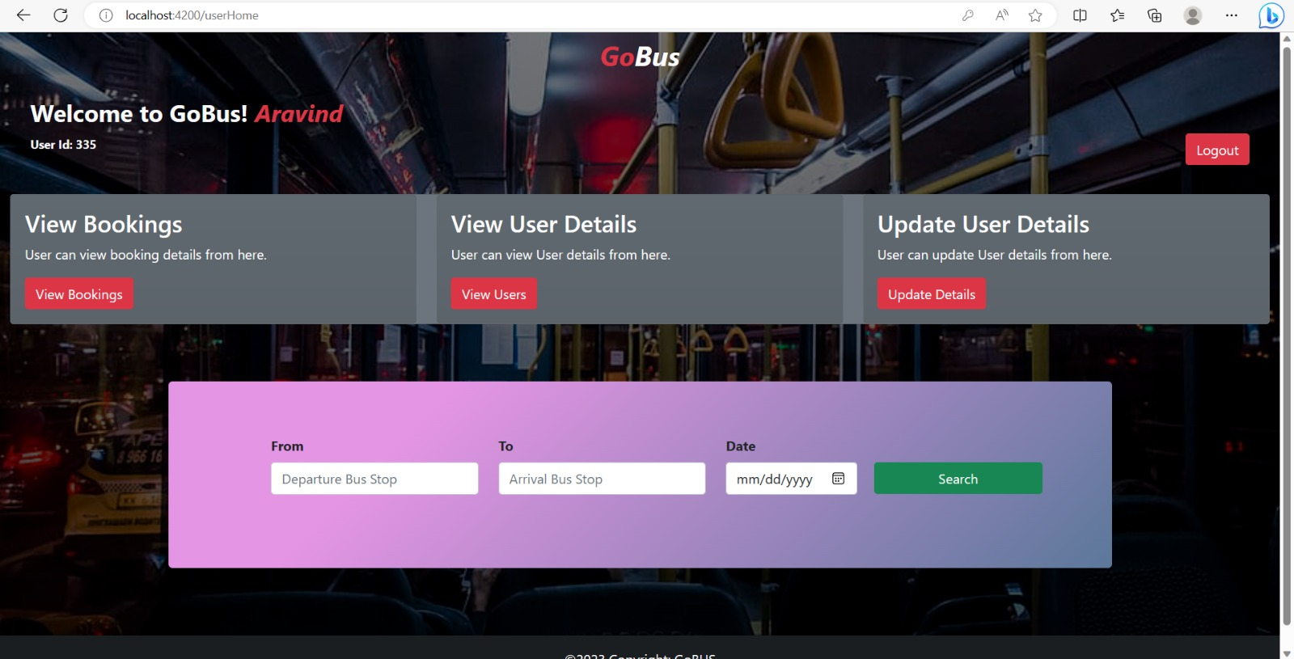
USER HOME PAGE

Slide 47
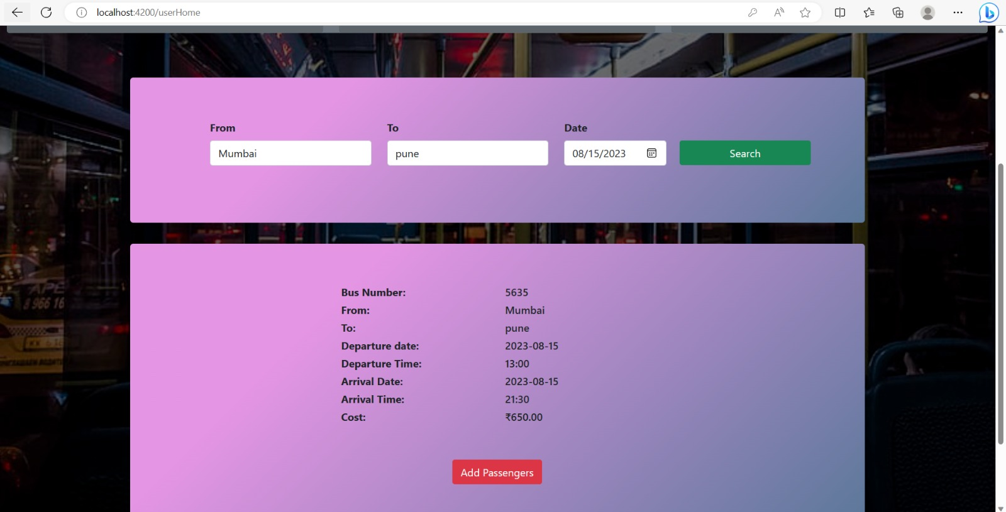
USER HOME PAGE(Valid Search)

Slide 48
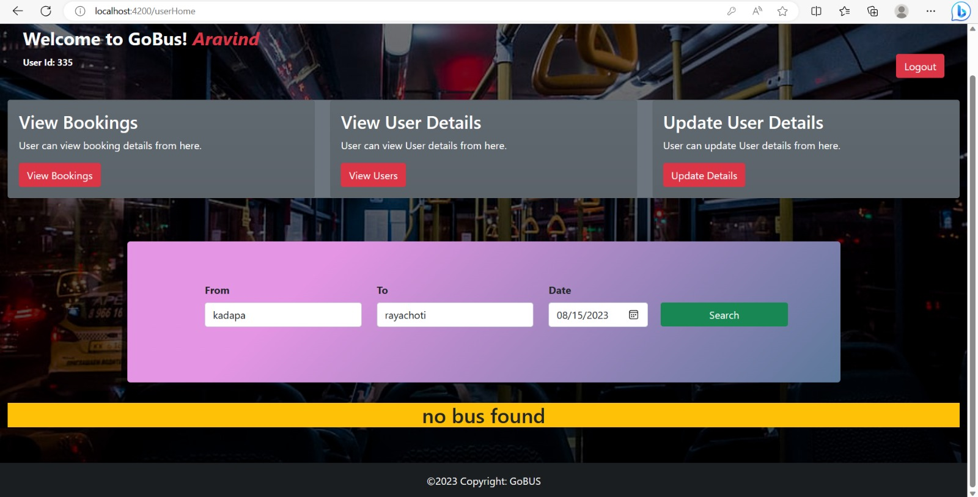
USER HOME PAGE(Invalid Search)

Slide 49
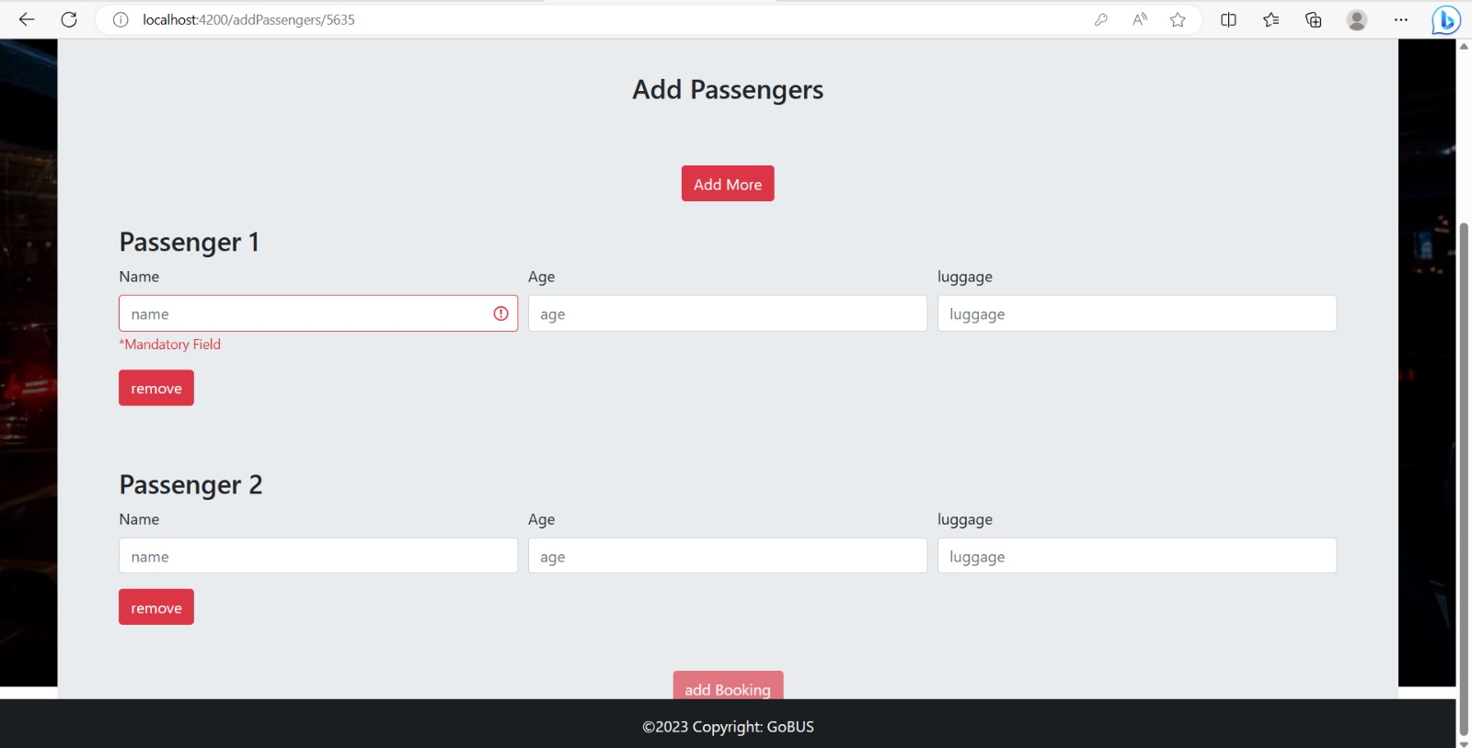
ADDING PASSENGERS

Slide 50
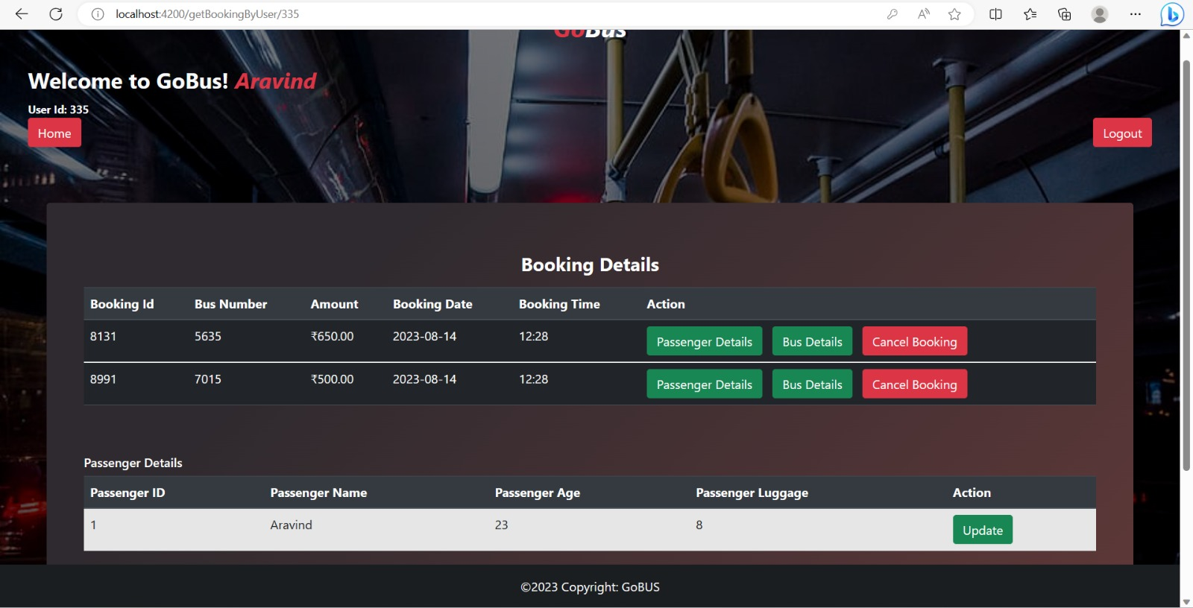
VIEW BOOKING BYUSER

Slide 51
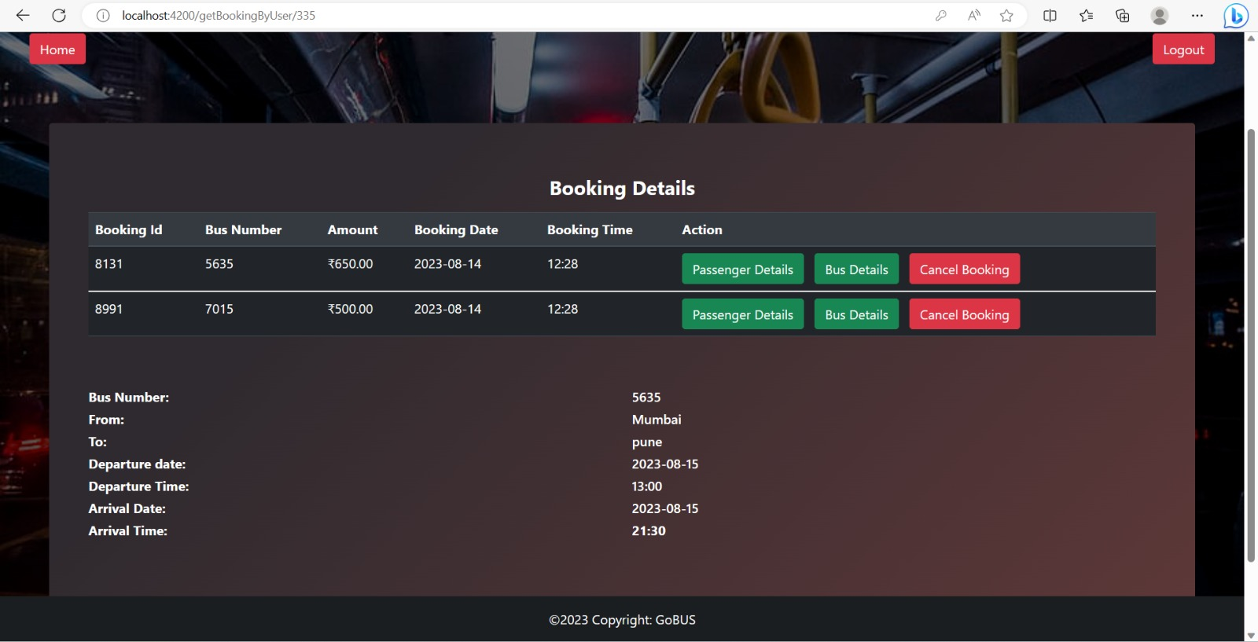
BUS DETAILS (IN BOOKING)

Slide 52
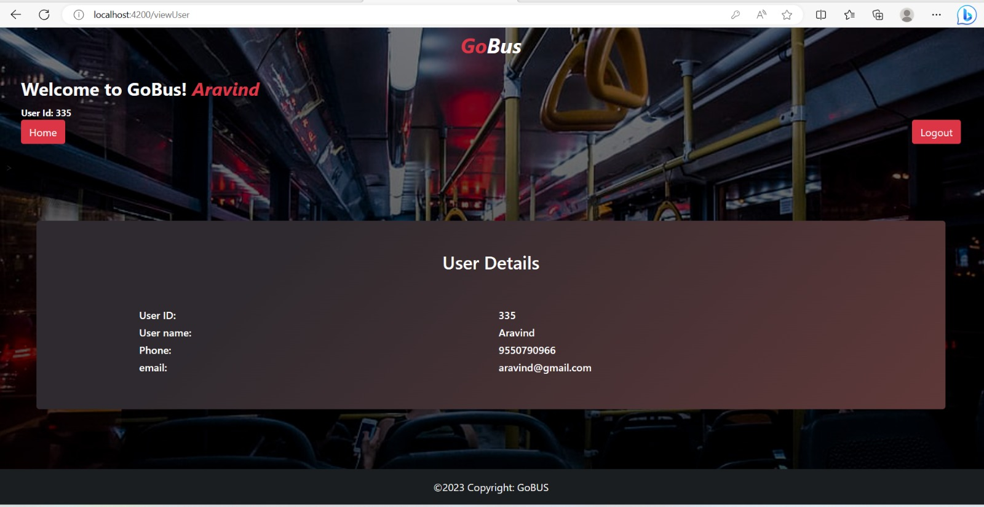
USER DETAILS

Slide 53
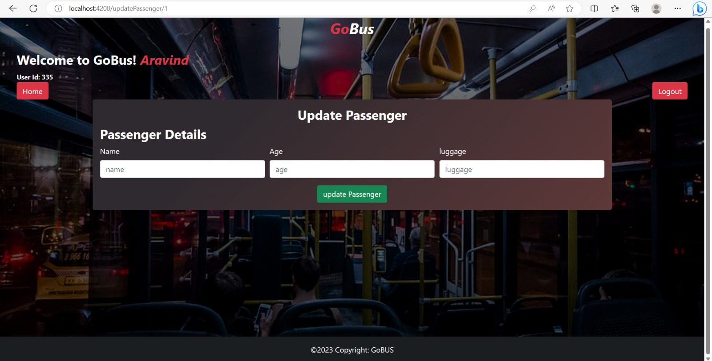
UPDATE PASSENGER DETAILS

Slide 54
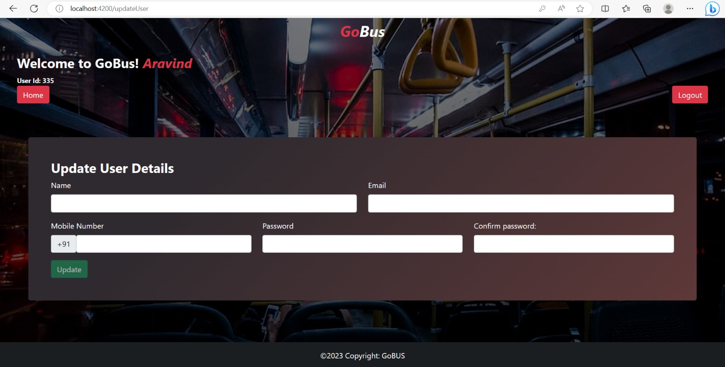
UPDATE USER DETAILS

Slide 55
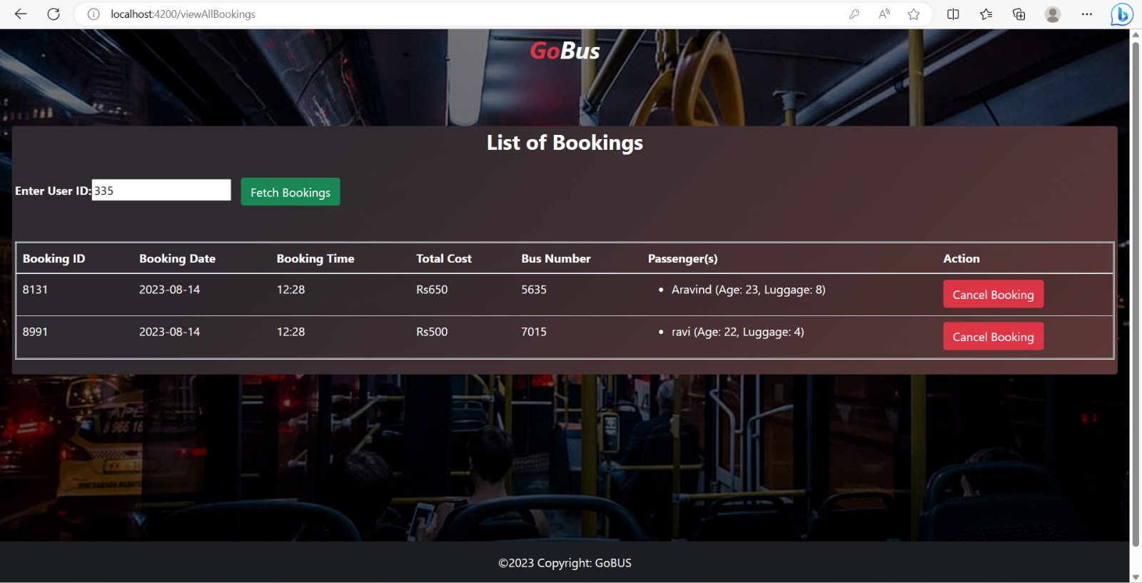
VIEW ALL BOOKINGS (Admin)

Slide 56
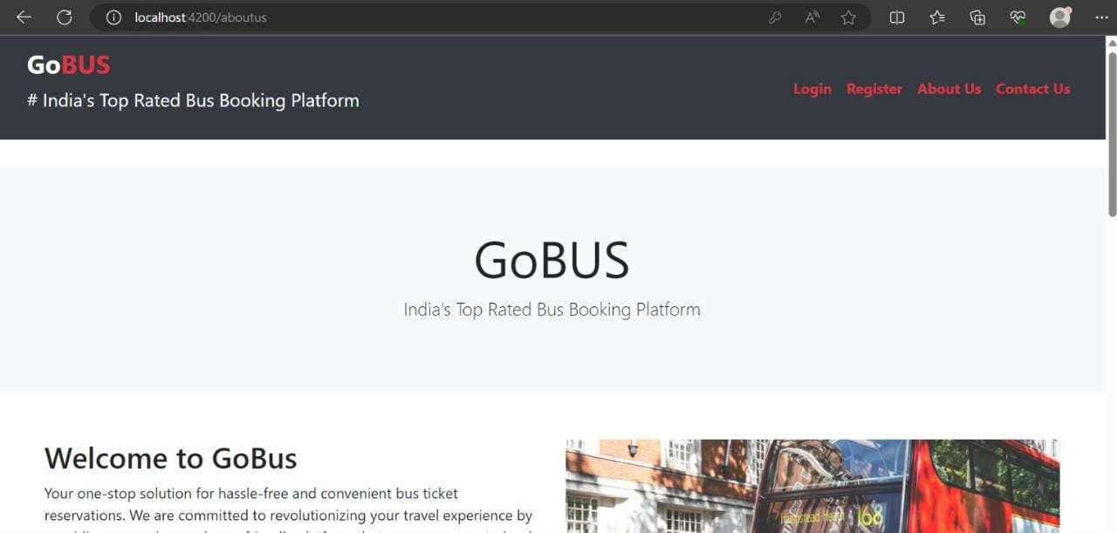
ABOUT US

Slide 57
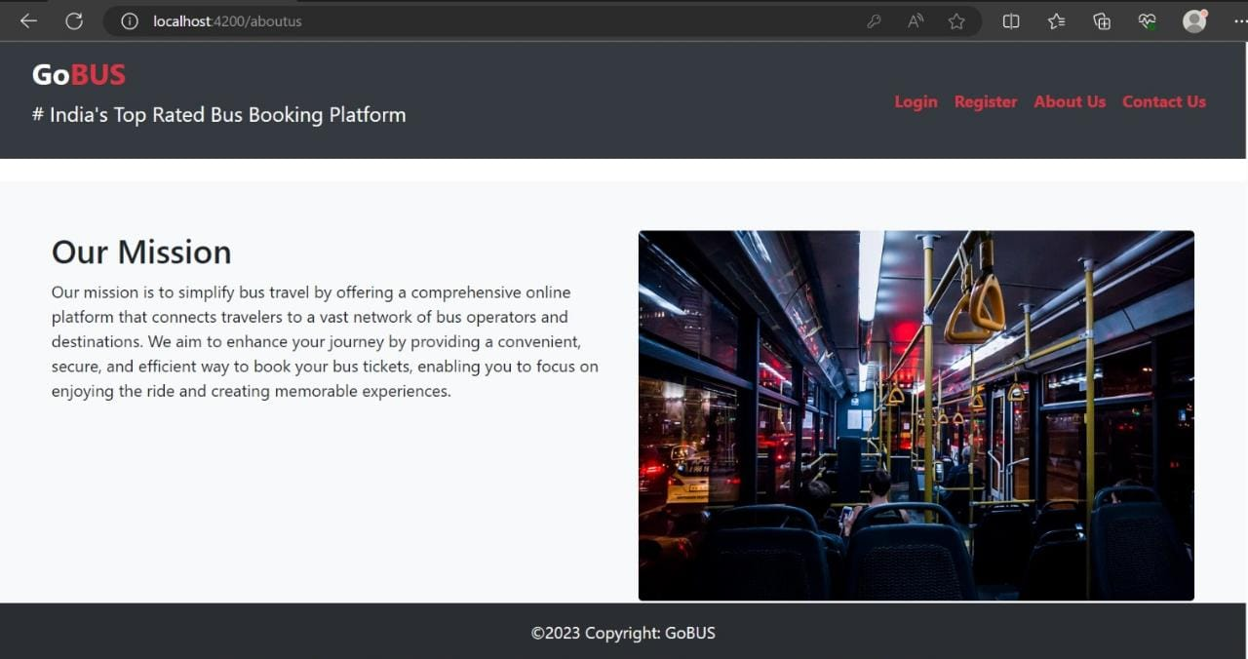
OUR MISSION

Slide 58
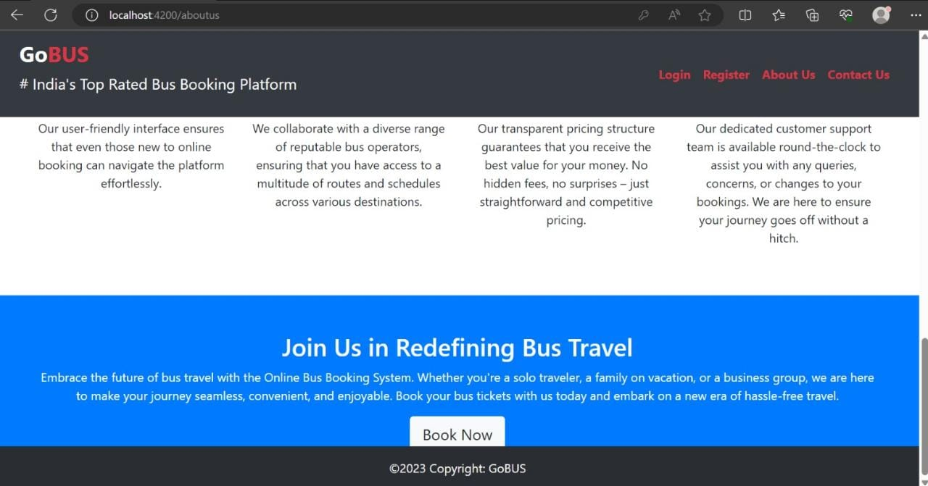

Slide 59
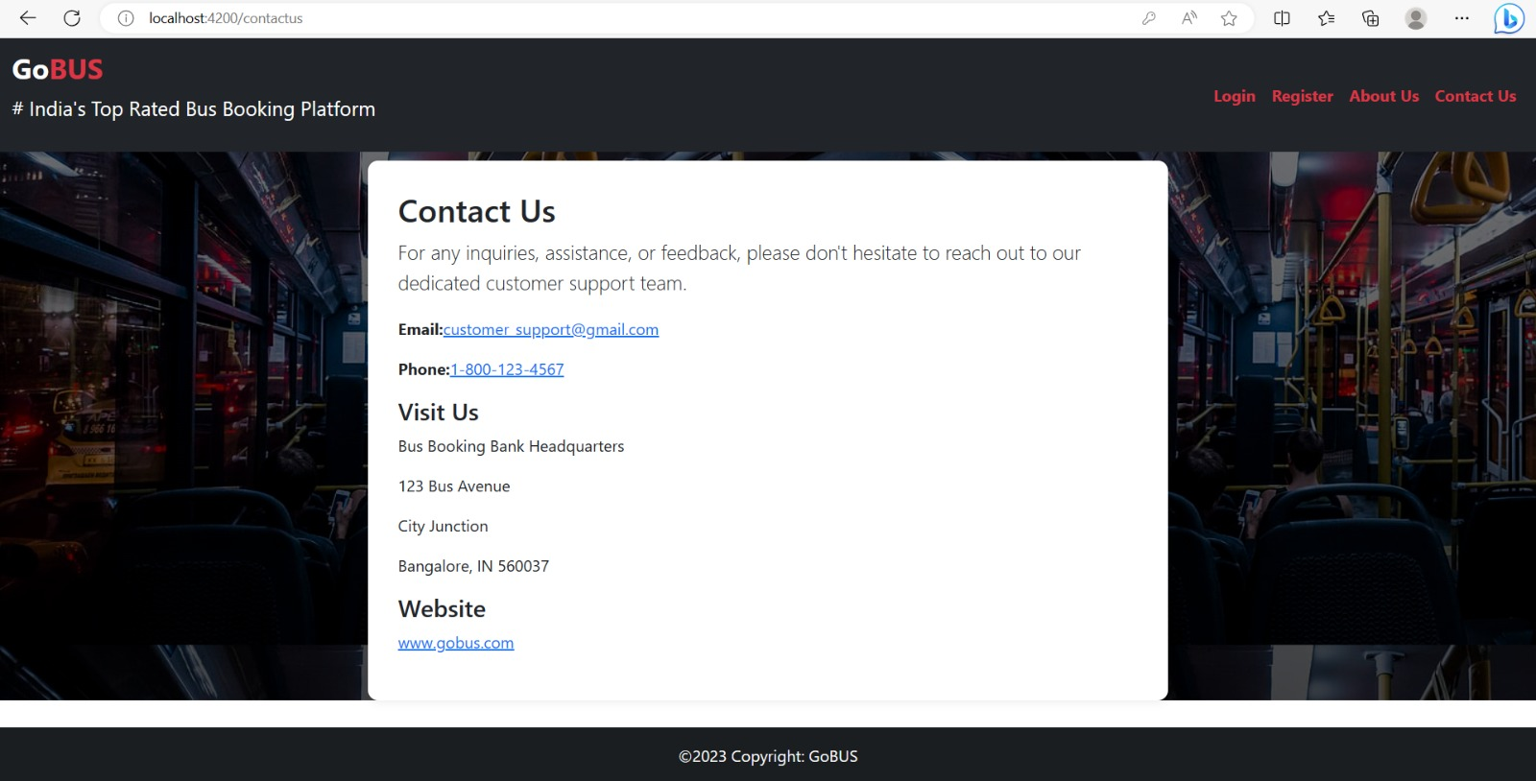
CONTACT US

Slide 60


